Slide 1





Order Fulfillment Along the Supply Chain
and Other Support Services

Slide 2


Learning Objectives
Describe the role of support services in electronic
commerce (EC).
Define EC order fulfillment and describe the EC order fulfillment process.
Describe the major problems of EC order fulfillment.
Describe various solutions to EC order fulfillment problems.
Describe RFID supply chain applications.
Describe collaborative planning and the CPFR model.
Describe other EC support services.
Discuss the drivers of outsourcing support services.

Slide 3

Order Fulfillment and Logistics: An Overview
ACQUIRING GOODS AND SERVICES
order fulfillment
All the activities needed to provide customers with their ordered goods and services, including related customer services
back-office operations
The activities that support fulfillment of orders, such as
packing, delivery, accounting, and logistics
front-office operations
The business processes, such as sales and advertising,
which are visible to customers

Slide 4

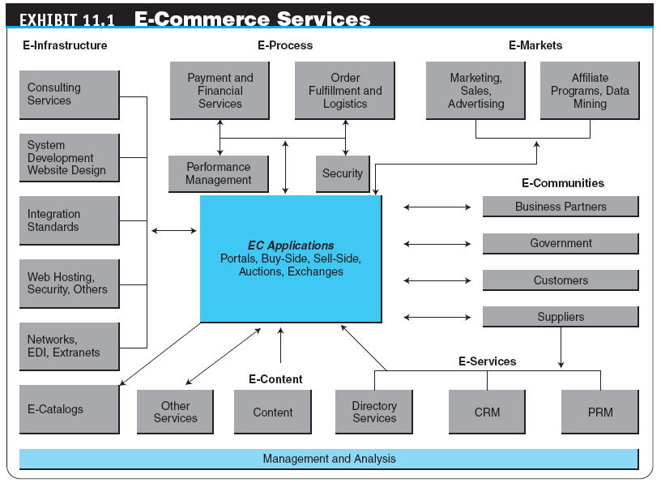

Slide 5

Order Fulfillment and Logistics: An Overview
logistics
The operations involved in the efficient and effective flow and storage of goods, services, and related information from point of origin to point of consumption
e-logistics
The logistics of EC systems, typically involving small parcels sent to many customers’ homes (in B2C)

Slide 6
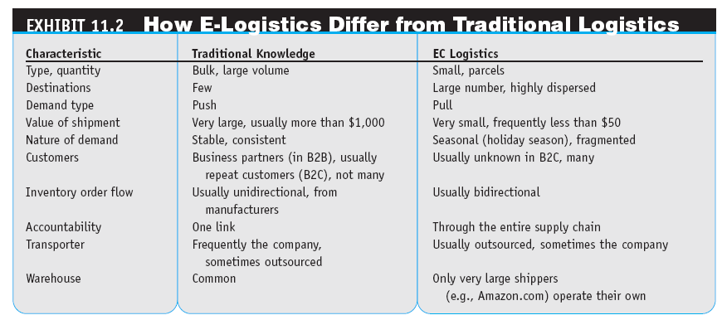

Slide 7

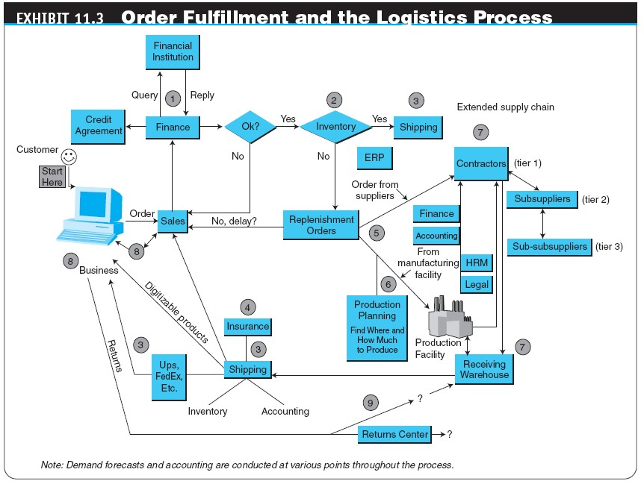

Slide 8
Order Fulfillment and Logistics: An Overview
THE EC ORDER FULFILLMENT PROCESS
Activity 1: Making sure the customer will pay
Activity 2: Checking for in-stock availability
Activity 3: Arranging shipments
Activity 4: Insurance
Activity 5: Replenishment
Activity 6: In-house production
Activity 7: Use contractors
Activity 8: Contacts with customers
Activity 9: Returns

Slide 9

Order Fulfillment and Logistics: An Overview
reverse logistics
The movement of returns from customers to vendors
The Administrative Activities of Order Taking and
Fulfillment
Order Fulfillment and the Supply Chain

Slide 10

Problems in
Order Fulfillment Along Supply Chains
TYPICAL SUPPLY CHAIN PROBLEMS
WHY SUPPLY CHAIN PROBLEMS EXIST
third-party logistics suppliers (3PL)
External, rather than in-house, providers of logistics services
Inefficient Financial Supply Chains Can Grind Businesses to a Halt
The Need for Information Sharing Along the Supply Chain

Slide 11

Solutions to Order Fulfillment Problems Along Supply Chains
IMPROVEMENTS IN THE ORDER-TAKING ACTIVITY
Electronic Payments in E-Commerce
warehouse management system (WMS)
A software system that helps in managing warehouses
Other Warehousing and Inventory Management Improvements
Automated Warehouses
Using Wireless Technologies

Slide 12

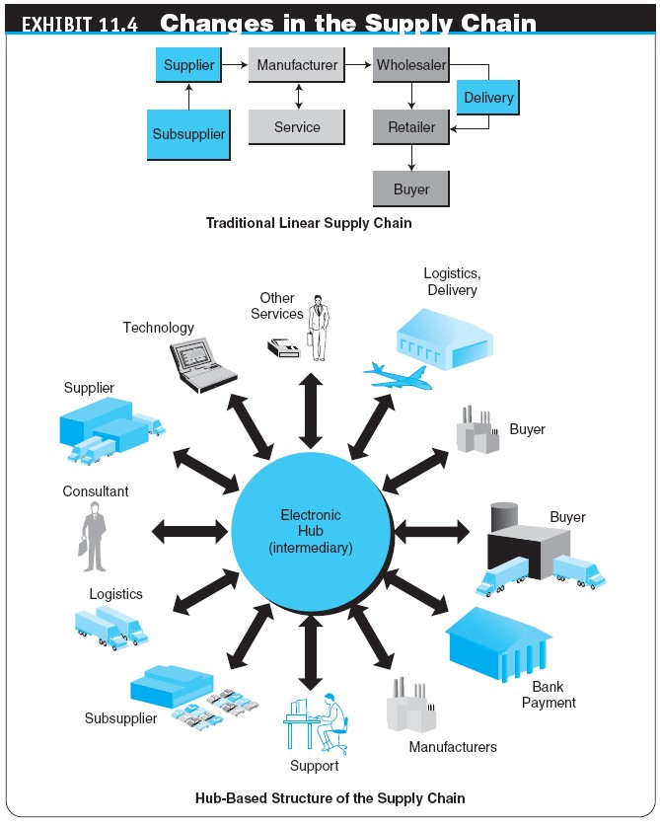

Slide 13
Solutions to Order Fulfillment Problems Along Supply Chains
SPEEDING DELIVERIES
Same-Day, Even Same-Hour, Delivery
Supermarket Deliveries
PARTNERING EFFORTS AND OUTSOURCING LOGISTICS
Comprehensive Logistics Services
Outsourcing Logistics

Slide 14
Solutions to Order Fulfillment Problems Along Supply Chains
INTEGRATED GLOBAL LOGISTICS SYSTEMS
ORDER FULFILLMENT IN MAKE-TO-ORDER AND MASS CUSTOMIZATION
Fulfilling Orders

Slide 15

Solutions to Order Fulfillment Problems Along Supply Chains
HANDLING RETURNS (REVERSE LOGISTICS)
Return the item to the place of purchase
Separate the logistics of returns from the logistics of delivery
Completely outsource returns
Allow the customer to physically drop the returned item at a collection station
Auction the returned items

Slide 16
Solutions to Order Fulfillment Problems Along Supply Chains
ORDER FULFILLMENT IN B2B
Using BPM to Improve Order Fulfillment
Using E-Marketplaces and Exchanges to Ease Order Fulfillment Problems in B2B
Order Fulfillment in Services
Copyright © 2012 Pearson Education, Inc.
Publishing as Prentice Hall
11-15

Slide 17

Solutions to Order Fulfillment Problems Along Supply Chains
OTHER SOLUTIONS TO SUPPLY CHAIN PROBLEMS
visibility
The knowledge about where materials and parts are at any given time, which helps in solving problems such as delay, combining shipments, and more
Order fulfillment
Managing risk
Inventories can be minimized
Self-service
Collaborative commerce
Copyright © 2012 Pearson Education, Inc.
Publishing as Prentice Hall
11-16

Slide 18
Solutions to Order Fulfillment Problems Along Supply Chains
INNOVATIVE E-FULFILLMENT STRATEGIES
merge-in-transit
Logistics model in which components for a product may come from two (or more) different physical locations
and are shipped directly to the customer’s location
rolling warehouse
Logistics method in which products on the delivery truck are not preassigned to a destination, but the decision about the quantity to unload at each destination is made at the time of unloading
Copyright © 2012 Pearson Education, Inc.
Publishing as Prentice Hall
11-17

Slide 19
Solutions to Order Fulfillment Problems Along Supply Chains
Example: A World-Class Supply Chain and Order Fulfillment System Works at Dell
Integration and Enterprise Resource Planning
The Supply Chains of Tomorrow
11-18

Slide 20

RFID and CPFR as Key Enablers in Supply Chain Management
radio frequency identification (RFID)
Tags that can be attached to or embedded in objects, animals, or humans and use radio waves to communicate with a reader for the purpose of uniquely identifying the object or transmitting data and/or storing information about the object
11-19

Slide 21

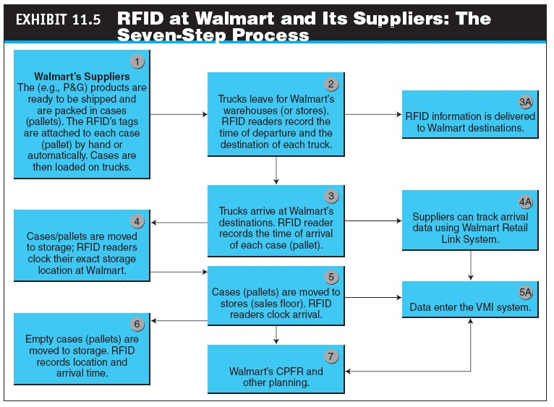
11-20

Slide 22
RFID and CPFR as Key Enablers in Supply Chain Management
RFID APPLICATIONS IN THE SUPPLY CHAIN AROUND THE GLOBE
RFID at Metro AG-Germany
RFID at Starbucks
RFID at Deutsche Post (Germany)
RFID in the Federal Government (U.S. Department of Defense)
11-21

Slide 23

RFID and CPFR as Key Enablers in Supply Chain Management
RFID at Atlantic Beef Products (Ontario, Canada)
RFID at Yodobashi Camera Handles Inventory of About 1 Million Items (Japan)
RFID in Pharmaceuticals
Jeweler Gains Efficiency and Improves Customer Service with RFID (India)
Other Uses
11-22

Slide 24

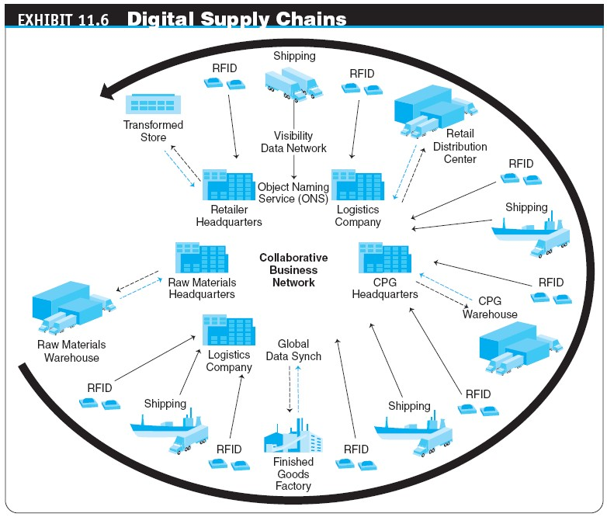
11-23

Slide 25

RFID and CPFR as Key Enablers in Supply Chain Management
collaborative planning, forecasting, and replenishment (CPFR)
Project in which suppliers and retailers collaborate in their planning and demand forecasting to optimize
flow of materials along the supply chain
11-24

Slide 26

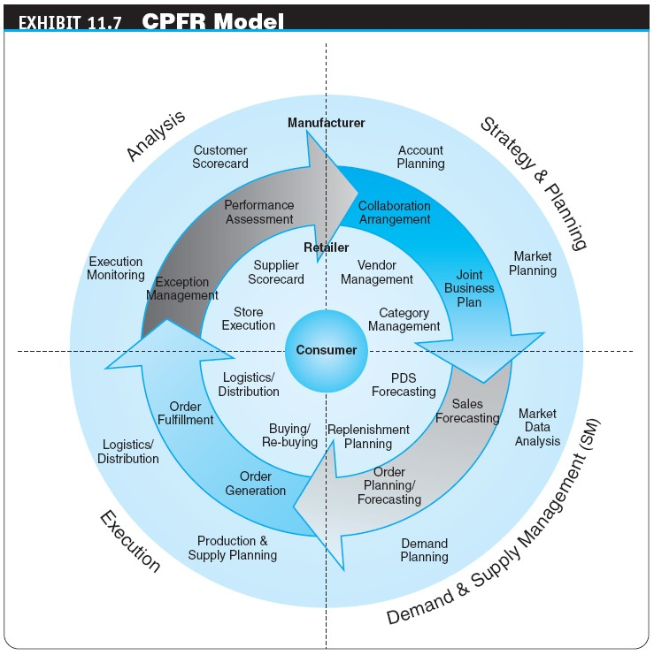
11-25

Slide 27
Other E-Commerce Support Services
CONSULTING SERVICES
Online Consulting
Directory Services
Newsletters
Search Engines and News Aggregators
11-26

Slide 28
Other E-Commerce Support Services
MORE EC SUPPORT SERVICES
Trust Services
Trademark and Domain Names
Digital Photos
Global Business Communities
Access to Commercial Databases
Knowledge Management
Client Matching
E-Business Rating Sites
Security and Encryption Sites
Web Research Services
Coupon-Generating Sites
11-27

Slide 29
Other E-Commerce Support Services
OUTSOURCING EC SUPPORT SERVICES
Why Outsource EC Services?
IT Outsourcing and Application Service Providers
application service provider (ASP)
An agent or vendor who assembles the functions needed by enterprises and packages them with outsourced development, operation, maintenance, and other services
Copyright © 2012 Pearson Education, Inc. Publishing as Prentice Hall
11-28

Slide 30

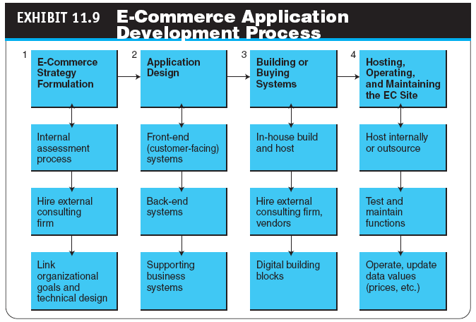
11-29

Slide 31
Managerial Issues
If you are an EC vendor, what is the bottleneck in the order fulfillment process?
For which items should we keep our own inventory?
What is the alliance strategy in order fulfillment?
How should we manage returns?
What logistics information should we provide to customers?
Should we use RFID for the order fulfillment?
Can we use CPFR in SMEs?
11-30

Slide 32

Summary
The role of support services in EC
The order fulfillment process
Problems in order fulfillment
Solutions to order fulfillment problems
RFID tags
Collaborative planning and CPFR
Other support services
Outsourcing EC services
11-31

Slide 33
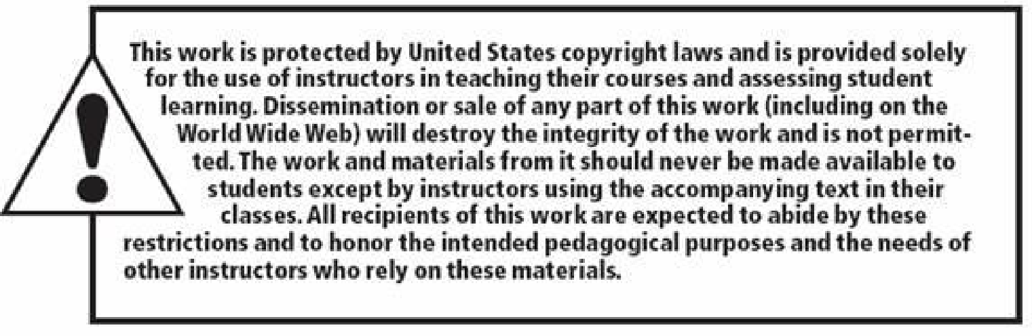




All rights reserved. No part of this publication may be reproduced, stored in a retrieval system, or transmitted, in any form or by any means, electronic, mechanical, photocopying, recording, or otherwise, without the prior written permission of the publisher. Printed in the United States of America.
Copyright © 2012 Pearson Education, Inc.
Publishing as Prentice Hall
11-32

